Slide 1
C-side Conference October 2021
Europroject Team Dendermonde Belgium

Slide 2
Óscar Romerocollege Dendermonde
warmly invites you @ the C-side Climate Conference
in October 2021

Slide 3
After the ...
MEGA
VIP
YEL
HEY
Conference ...
What is next?

Slide 4
@ the C-side?
At the Sea - side
At the Climate – side
With sCience
At the Culture – side
At the Creative side
And some Chocolate on the side
With sight C-ing
And a site to C

Slide 5
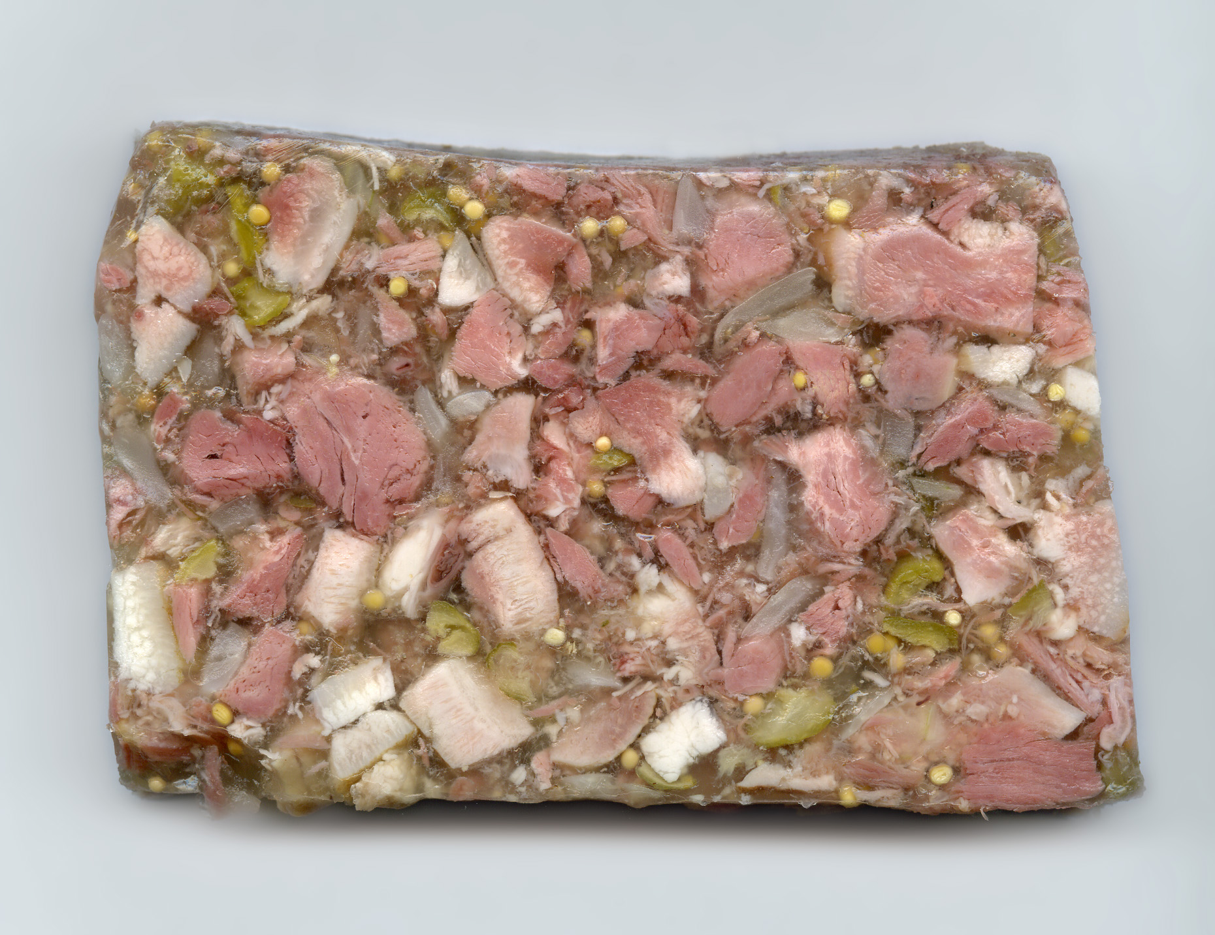
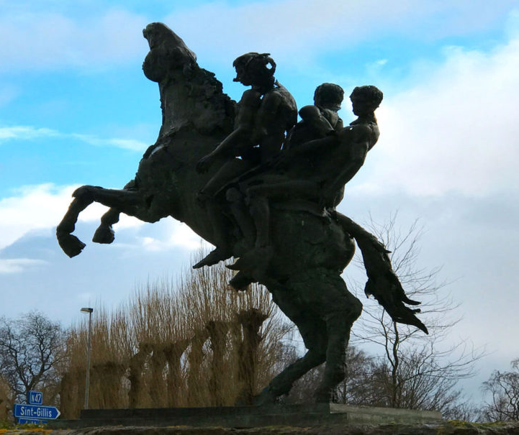
Why not in Dendermonde?

Slide 6
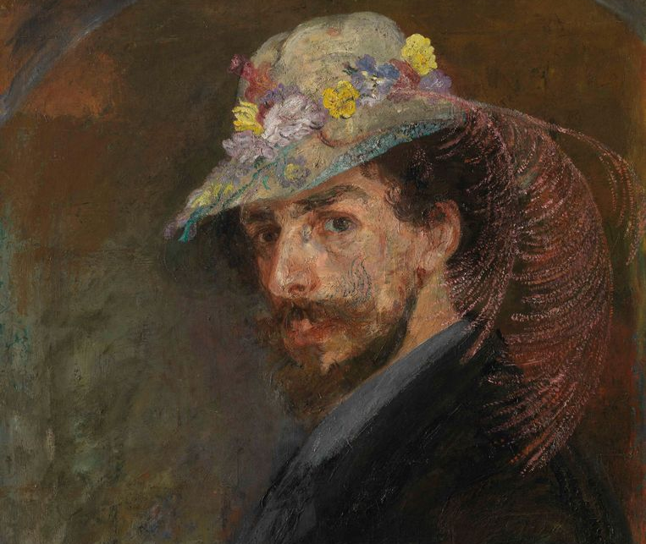
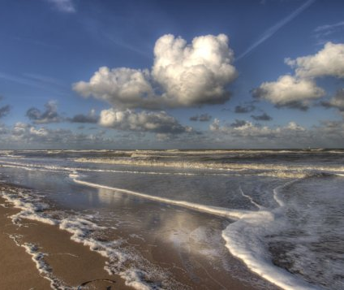
Oostende

Slide 7
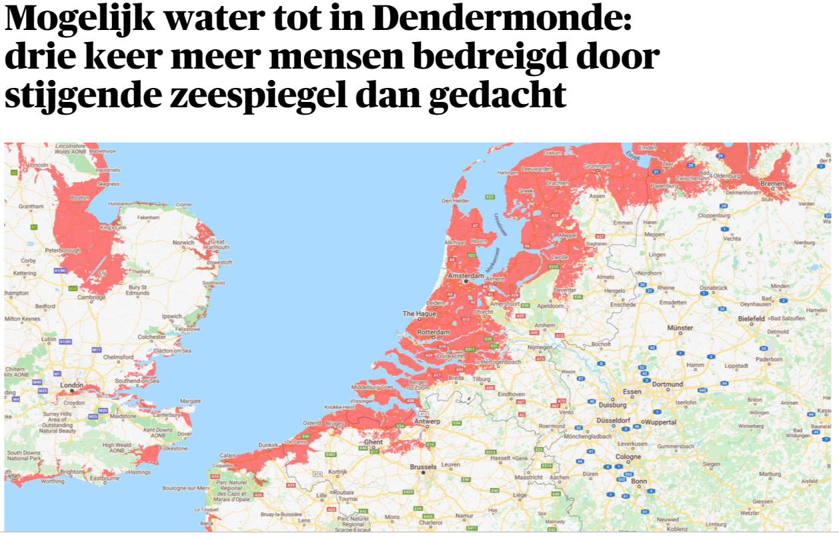

Slide 8
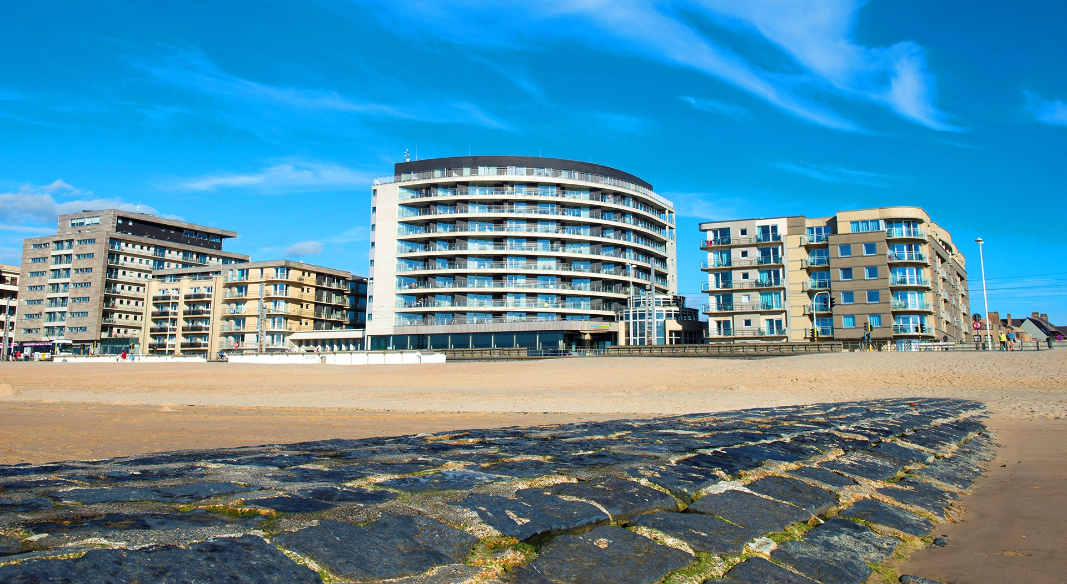
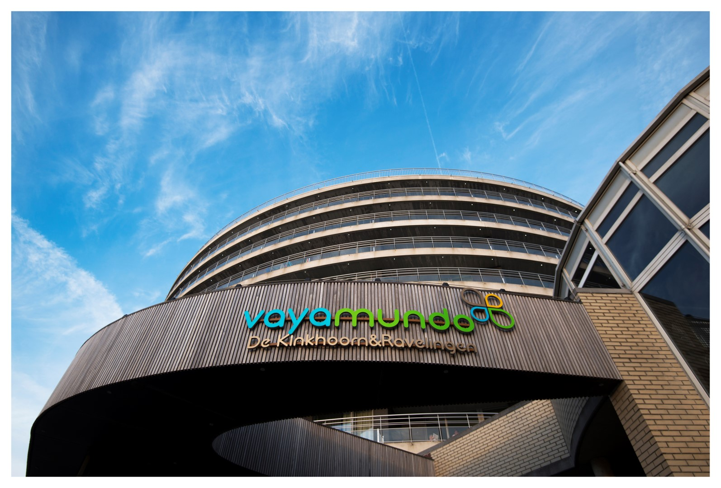
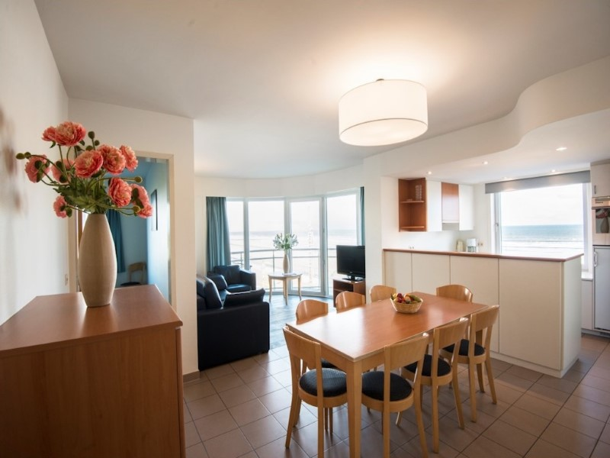
https://www.vayamundo.eu/Oostende

Slide 9
Special edition
The students stay with us at the seaside.
Students in apartments of 4-6 persons.
Teachers in single or double rooms.
Price includes all-in formula so a complete catering for students and staff:
Single Room 580 EUR p.p.
Double Room 500 EUR p.p.
Apartments for students 200 EUR p.p.

Slide 10
Who to bring?
Who to bring:
2 students age 16-18
2-3 members of staff

Slide 11
Program
Wednesday
Every delegation travels to Oostende (easy by train from Brussels Airport and from Brussels-Charleroi in about two hours)
Thursday
Opening ceremony and workshops
Friday
Excursion day: Dendermonde and Ghent
Dendermonde
Óscar Romerocollege
Ghent
Saturday
Workshops / network business
Outdoor activities in Oostende
Presentation of the workshop results in plenum
Farewell party
Sunday
Departure from Oostende

Slide 12
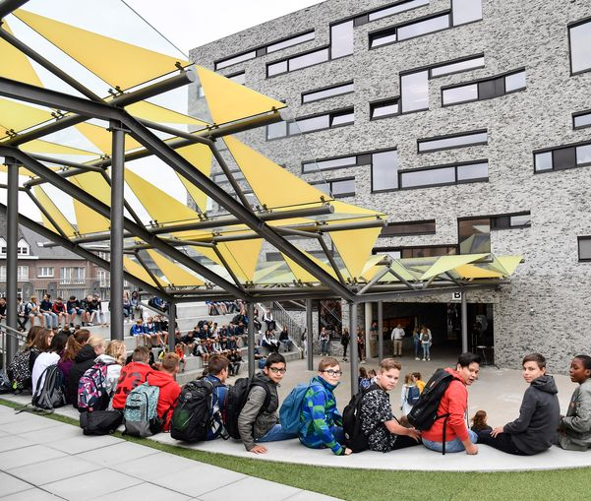
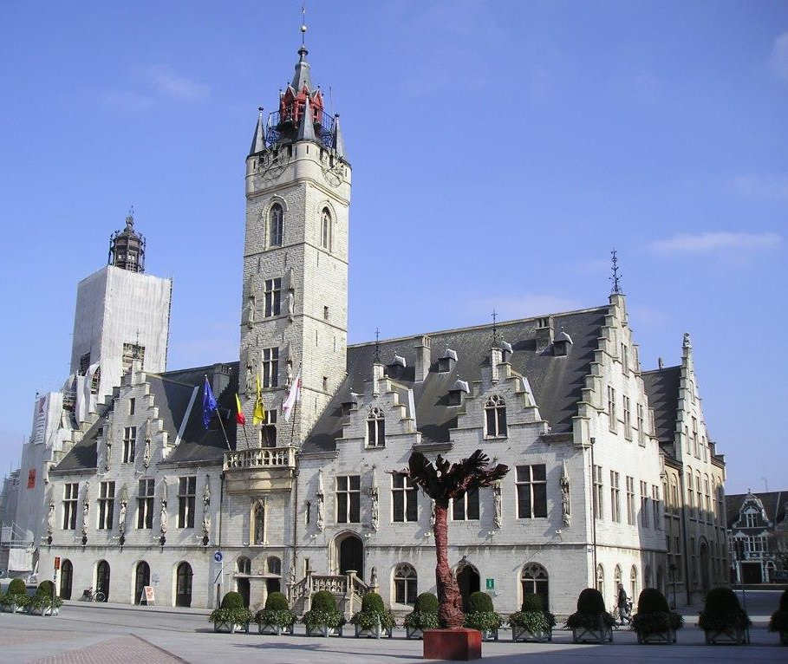
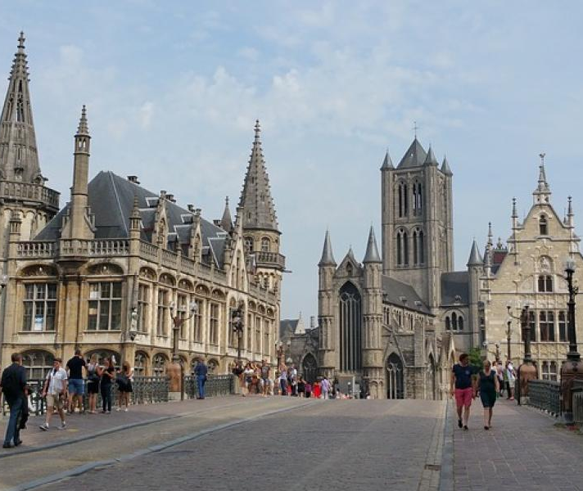
Excursion day

Slide 13
When?
Wednesday 06/10/2021 arrival in Oostende – Sunday 10/10/2021 departure from Oostende

Slide 14
Looking forward to welcoming you!

